Slide 1
Request for Exception
David Parker
Spencer Shadley
Cheng Ma

Slide 2
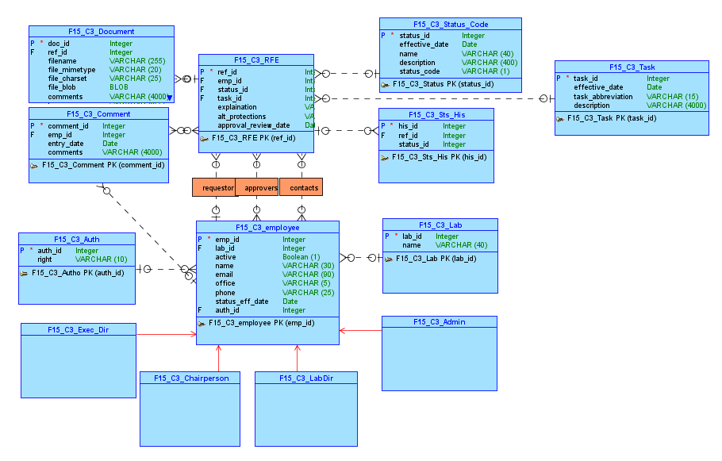
Part I - Conceptual Model

Slide 3
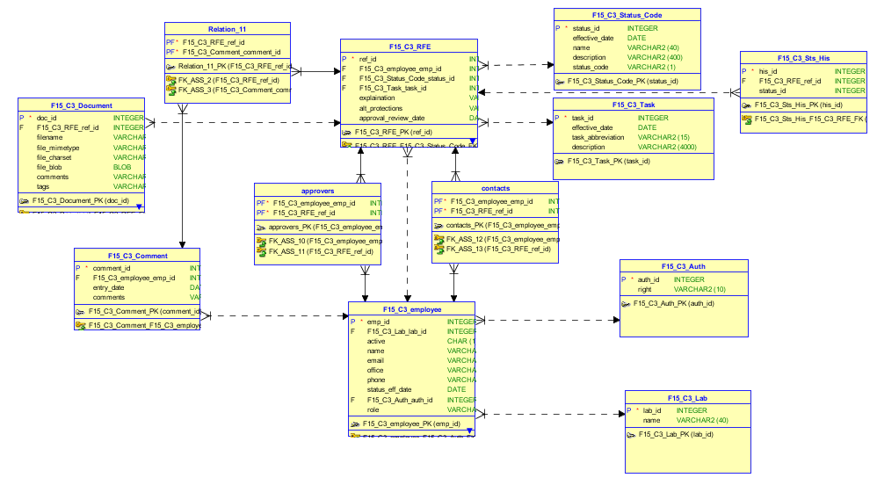
Part I - Relational Model

Slide 4
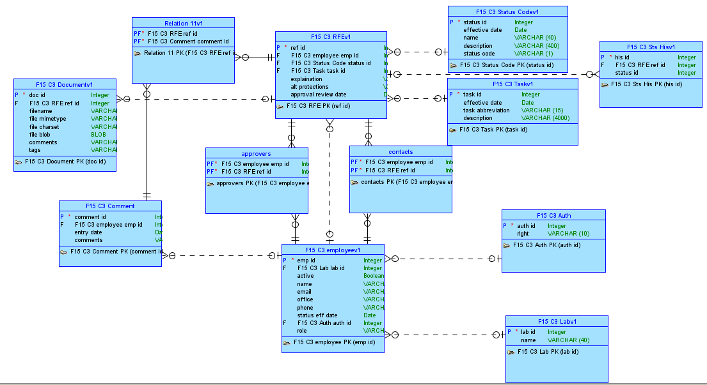
Part I - Logical Model

Slide 5
Our Apex Part I Application
Link To APEX

Slide 6
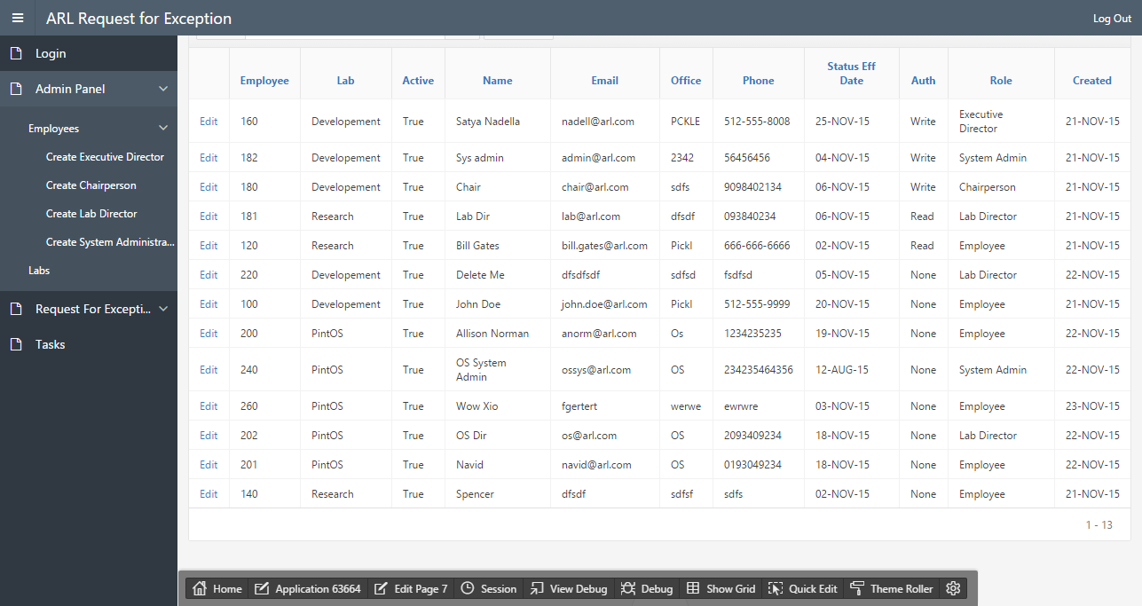

Slide 7
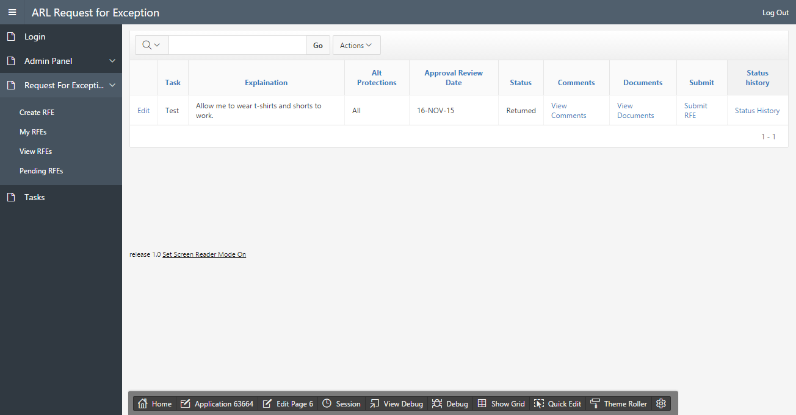

Slide 8
GitHub Link
https://github.com/David-Parker/F15_C3_Apex.git

Slide 9
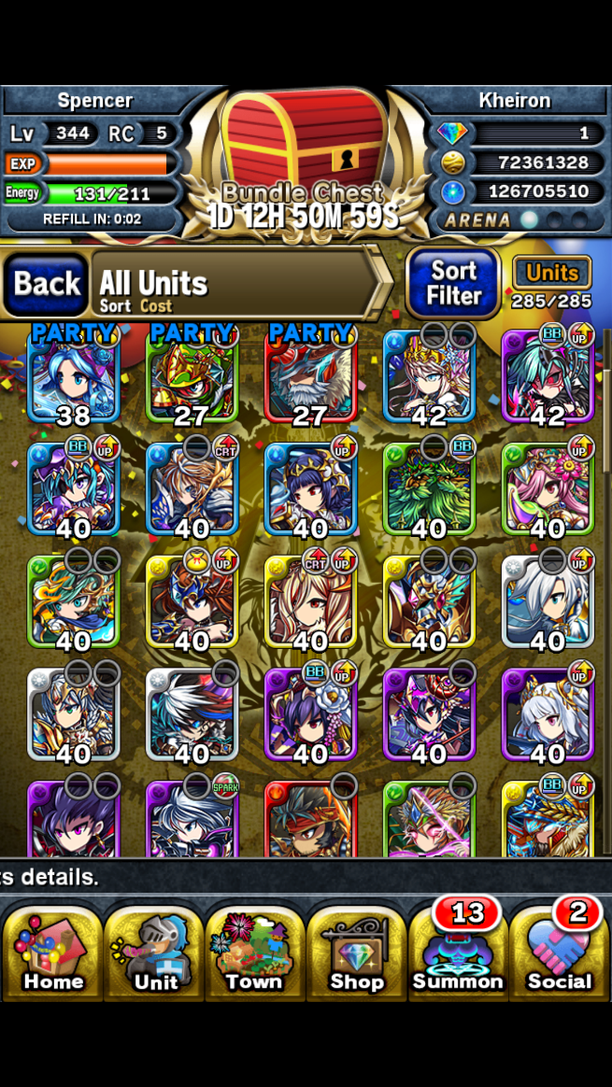
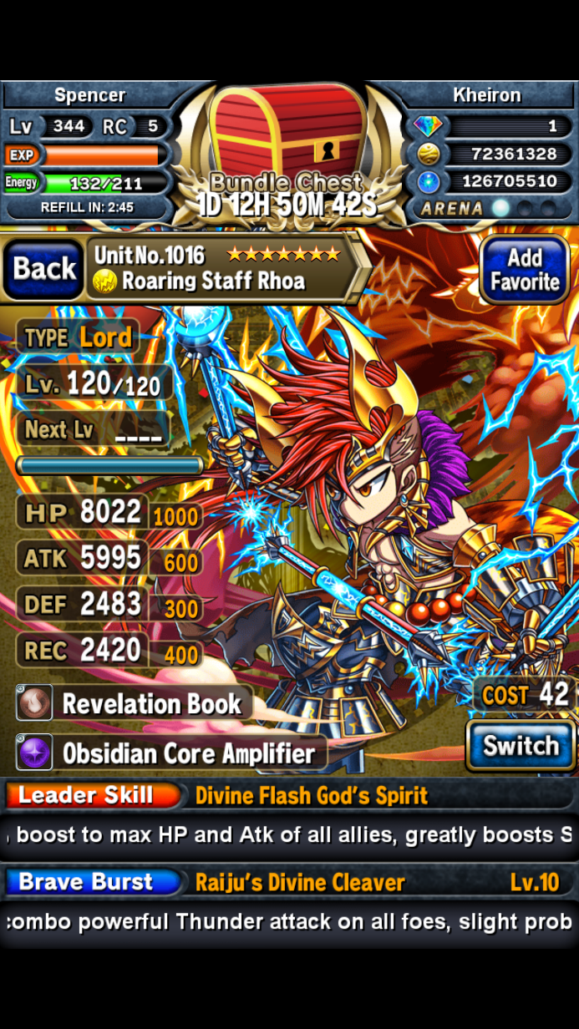
Part II – Brave Frontier
Brave Frontier is a mobile game in which players select five units to battle in various quests, vortexes and against other players
Each unit has a set of stats which are oftentimes unbalanced (high health but low recovery for example)

Slide 10
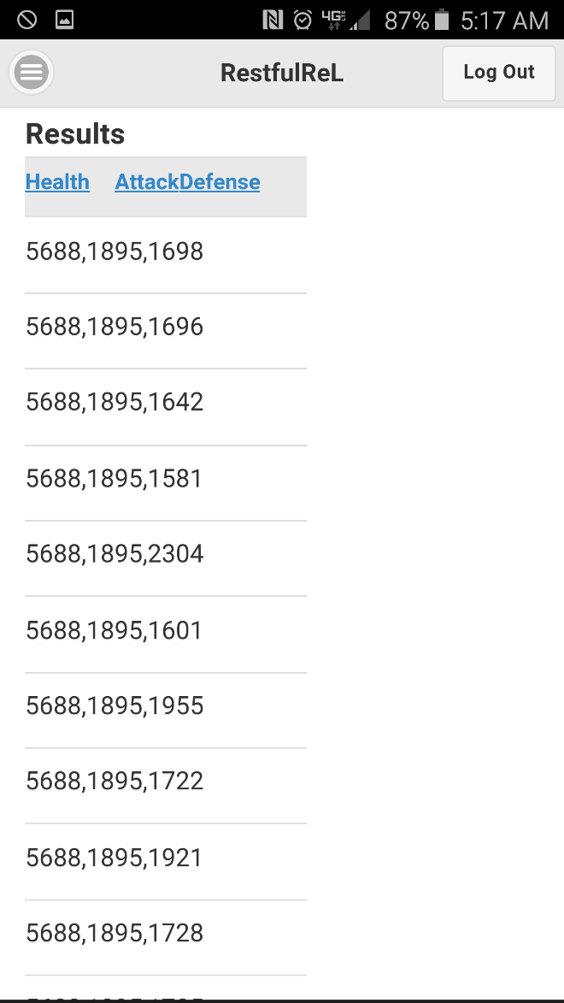
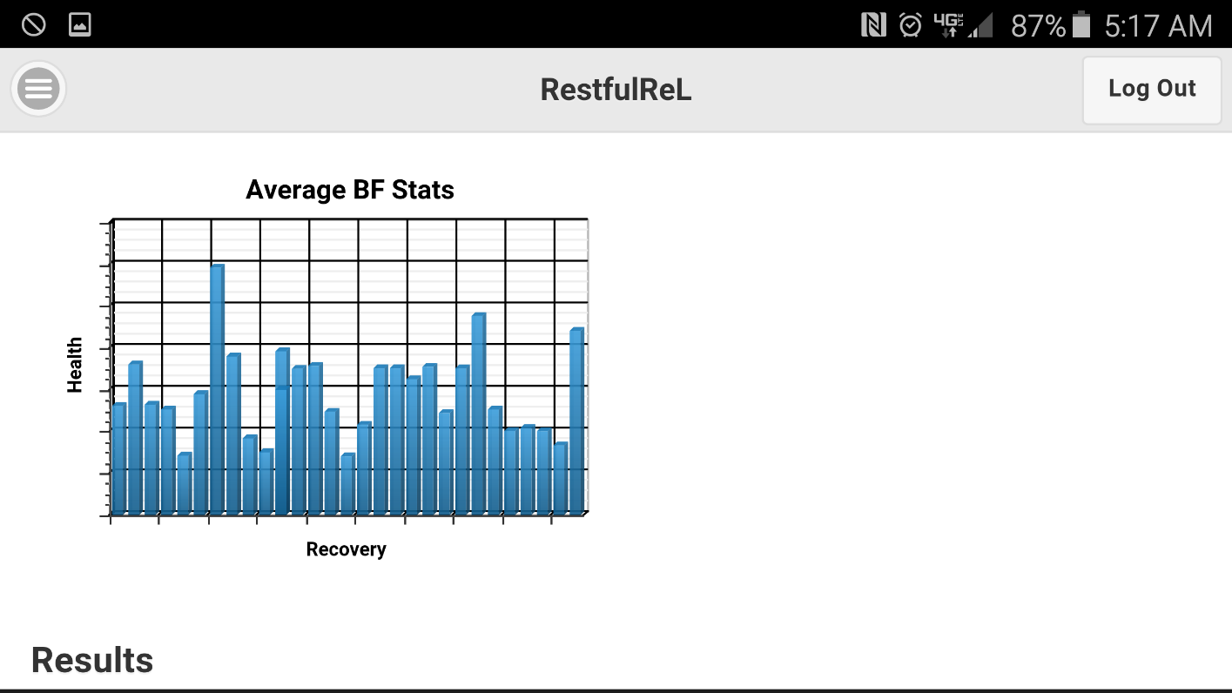
Part II – Brave Frontier
Our website allows the user to compare stats of various units with plots to allow easy comparisons. This will mitigate the need to try and compare unit by unit.

Slide 11
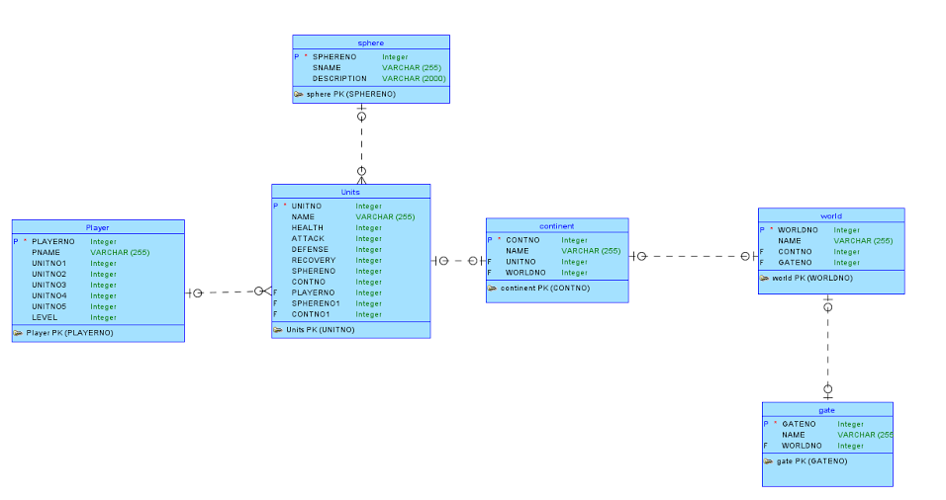
Part II - Conceptual Model

Slide 12
Our Apex Part II Application
Link to Part II

